Slide 1


Human Pose-Driven Fight Detection Using Random Forest and LSTM
This project explores violence detection in videos by analyzing human pose key points extracted from video frames. Three models were implemented: Random Forest, Long Short-Term Memory (LSTM), and Bidirectional LSTM (Bi-LSTM). The LSTM model achieved the highest accuracy of 75%, outperforming Random Forest (63%) and Bi-LSTM (65%). This highlights the advantage of sequential modeling in capturing temporal dependencies for fight detection.
The study aims to enhance real-time surveillance and security by leveraging pose-based features combined with deep learning architectures.
by karthik kosuri

Slide 2
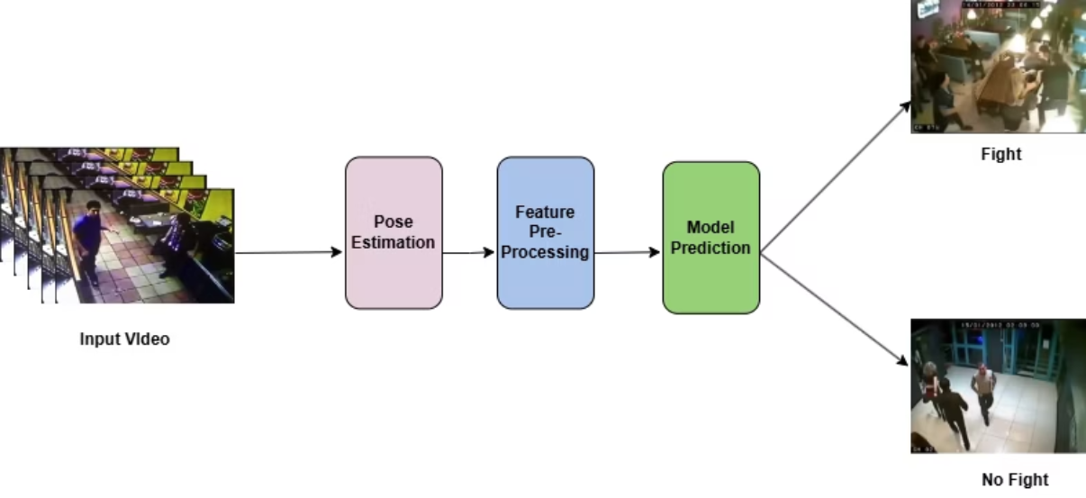
Introduction and Problem Statement
Introduction
Problem Statement
Automatic detection of violent activities like fights from video surveillance is crucial for public safety. Traditional motion-based methods struggle to distinguish aggressive behavior from normal interactions.
Existing violence detection methods rely on motion or pixel analysis, causing many false positives. They lack the ability to understand subtle postural differences indicating aggression.
This project uses pose estimation data—human body key points—to classify fight versus non-fight sequences using machine learning and deep learning models.
The goal is to develop a robust fight detection system using pose key points to better analyze physical interactions and reduce false alarms.

Slide 3

Objectives and Literature Review
Objectives
Develop an efficient system to detect fights in videos using pose-based features and machine learning models (Random Forest, LSTM, Bi-LSTM). Aim for accuracy, computational efficiency, and real-time applicability.
Literature Review
Key works include ST-GCN for skeleton-based action recognition, Random Forest for ensemble learning, and LRCN for temporal modeling with LSTMs.
Other contributions involve datasets like NTU RGB+D and architectures like Two-Stream CNNs that separate spatial and temporal features for action recognition.

Slide 4
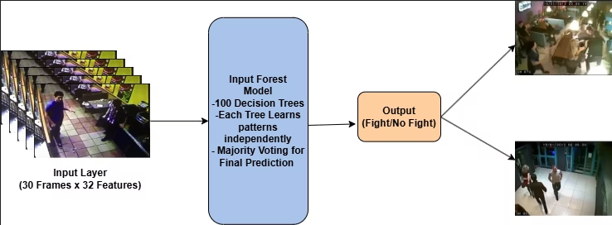
Data Collection and Preprocessing
Data Collection
Data Preprocessing
Videos labeled as fight or non-fight were processed to extract 132 pose features per frame (x and y coordinates of 66 keypoints). Videos were standardized to 30 frames using zero padding or uniform sampling.
Pose features were normalized to improve model convergence. The final input shape for models was (samples, timesteps, features) = (300, 30, 132).
No feature reduction was applied to preserve motion information, ensuring consistent input for all models.
The dataset of 300 samples was balanced and split 80:20 for training and testing with stratified sampling.

Slide 5

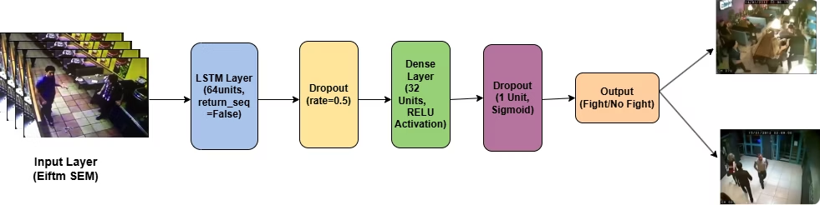
Model Architectures Overview
Random Forest Classifier
LSTM Model
Single LSTM layer with 64 units, dropout for regularization, followed by dense layers. Captures temporal dependencies, achieving 75% accuracy.
Ensemble of 100 decision trees trained on flattened pose features. Fast training but limited in capturing temporal dynamics, achieving 63% accuracy.
Bi-Directional LSTM
Two bidirectional LSTM layers capturing forward and backward temporal context. Slightly lower accuracy (65%) possibly due to overfitting on limited data.

Slide 6
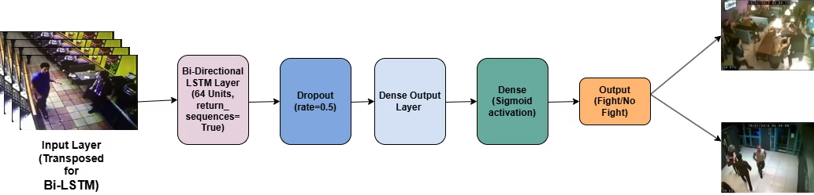
Training and Implementation Details
Training Setup
Implementation
Random Forest trained with 100 trees. LSTM and Bi-LSTM trained for 30 epochs using Adam optimizer and binary cross-entropy loss. Batch sizes: 16 for LSTM, 32 for Bi-LSTM.
Developed in Python using TensorFlow, Keras, scikit-learn, and other libraries. Models run efficiently on CPU without high-end hardware.
Models evaluated on accuracy, confusion matrix, and classification reports.
Input shape standardized to (30, 132) per video sample for consistent processing.

Slide 7

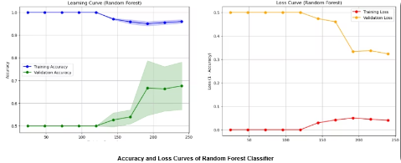
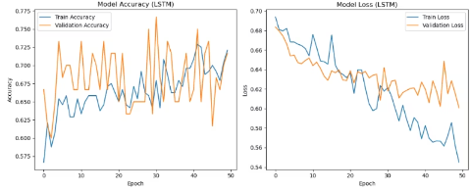
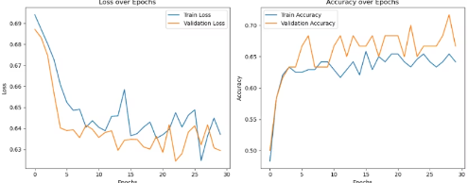
Results and Performance Analysis
1
Random Forest
63% accuracy; good baseline but limited by inability to model temporal sequences.
2
LSTM
75% accuracy; best performance due to temporal modeling and dropout regularization reducing overfitting.
3
Bi-LSTM
65% accuracy; captures bidirectional context but possibly overfits due to dataset size.

Slide 8
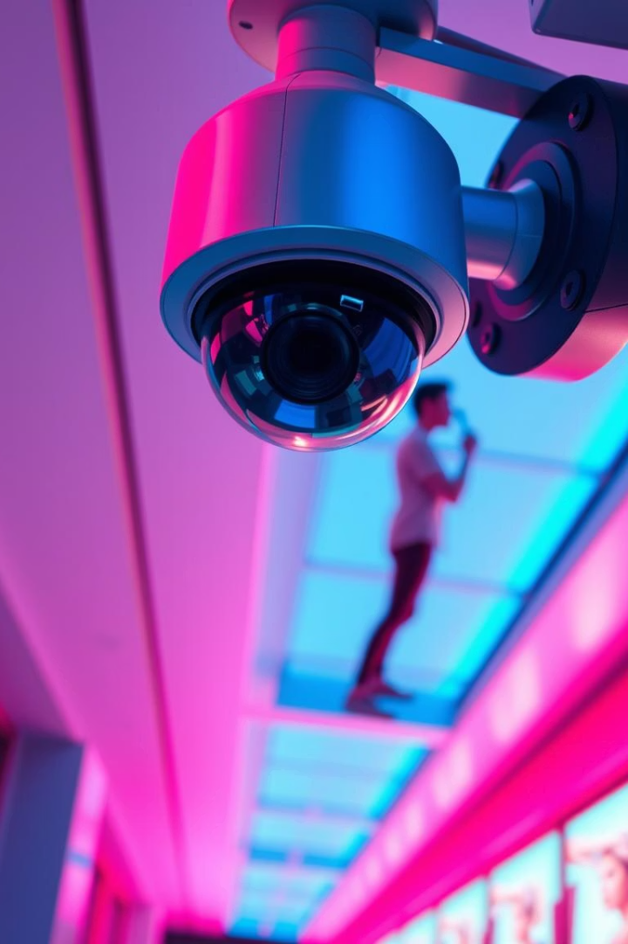



Conclusions, Challenges, and Future Work
Conclusions
LSTM model outperformed others, demonstrating the importance of temporal modeling in pose-based fight detection. Pose features combined with deep learning show promise for real-time surveillance.
Challenges
Limitations include reliance on pose estimation quality, small dataset size causing overfitting, and difficulty handling complex real-world fight scenes.
Future Work
Improving dataset size, integrating scene context and semantics, and optimizing models for better generalization and real-time deployment.

